Slide 1
A Taste of Differentiation

Slide 2
Slopes and Derivatives

Slide 3
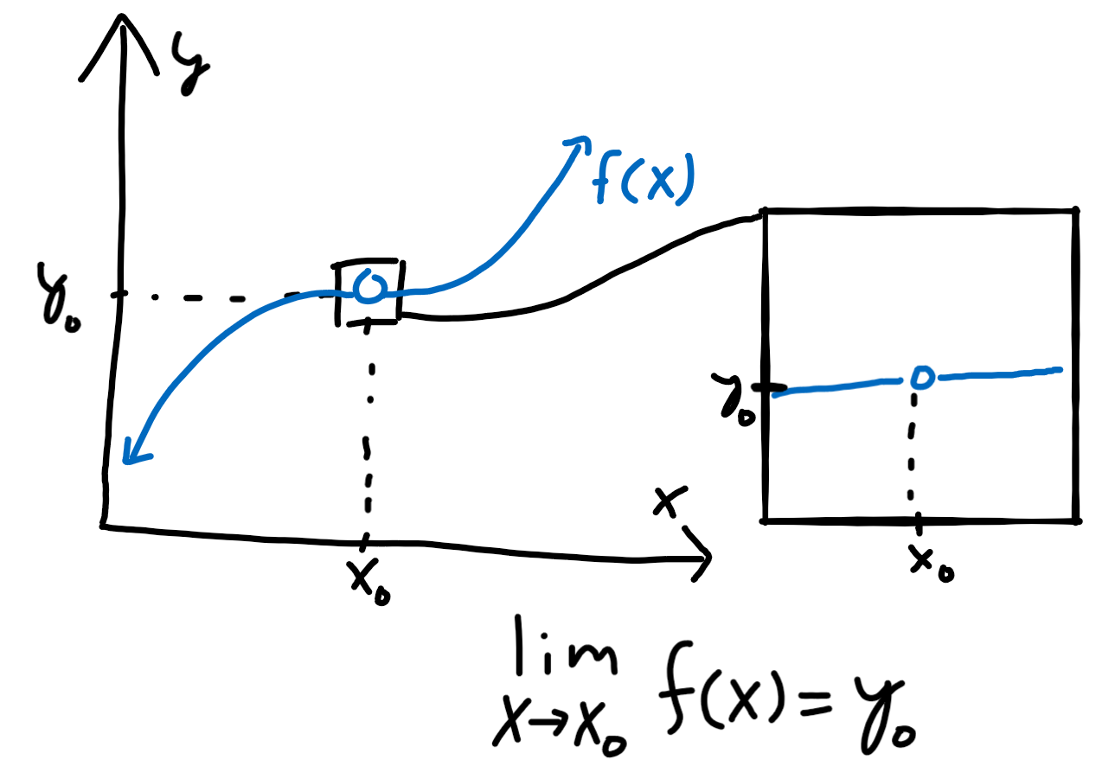
Limits
Let’s take a graph and remove a point from it.
How do we know which point we removed?
We can zoom in and see what the values of nearby points are and deduce that the removed point should be “very close” to the nearby points.
More concretely: we approach the point from both sides of the graph and see the trend very near, but not at, a particular point.
This is the idea behind taking a “limit” of a function.

Slide 4
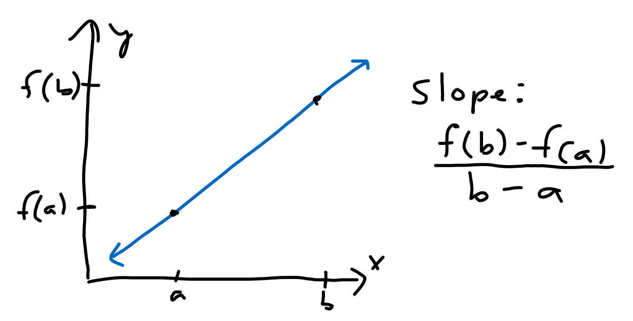
Slopes
We can calculate the “slope” of a line by taking the rise (change in y coordinate) and dividing it by the run (change in x coordinate).
For a line of the form y = f(x), the slope from a point x = a to x = b can be written as the fraction [f(b) - f(a)]/[b - a].

Slide 5
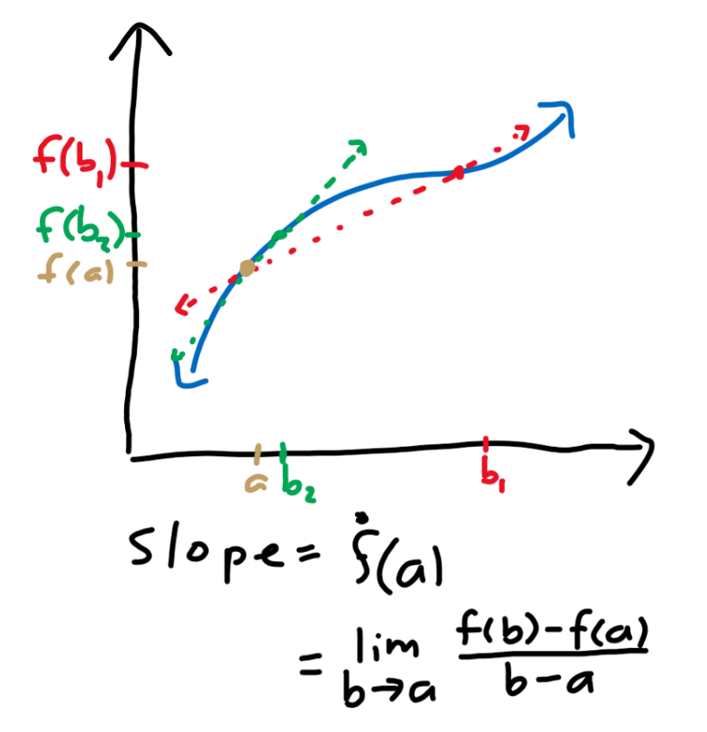
Derivatives
What about the slope for a non-linear curve?
We can approximate the slope at a certain point “a” as the slope of the line that passes through “a” and a nearby point “b.”
As b gets closer to a, our approximation gets better.
If we use our slope formula and take the limit as b approaches a, we get the slope of the curve at a point a.
We call the slope at a the value of the “derivative” of the curve at the point a.

Slide 6
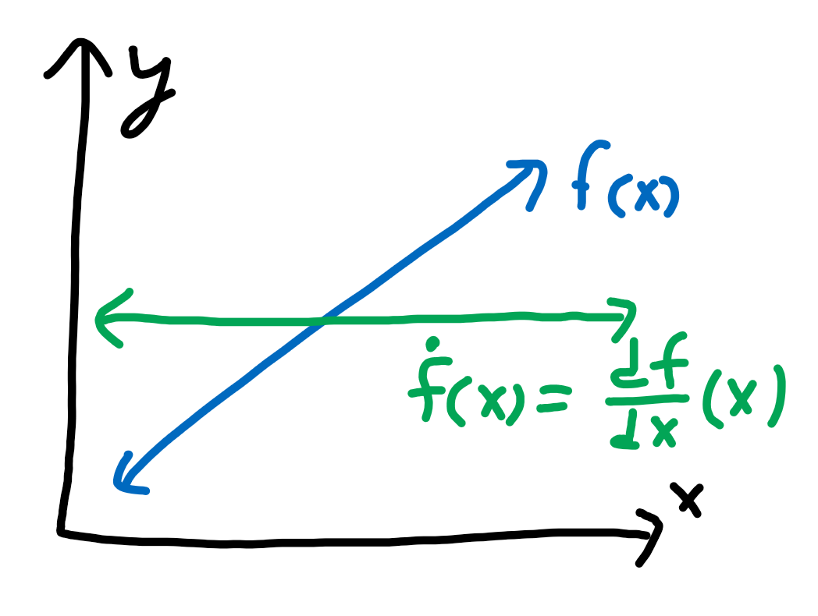
Derivatives as a function
We can plot the value of the derivative at every point to get the derivative as a function, which we denote as dy/dx where d represents a small change in.
Thus, dy/dx represents a small change in y divided by a small change in x, which is rise over run at a very small scale.

Slide 7
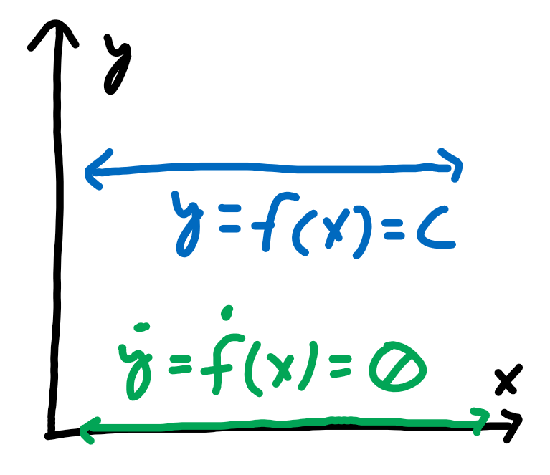
Derivative of a constant
The constant function y = c has a slope of 0 everywhere, so the derivative dy/dx of the function y = c is 0.

Slide 8
Taylor Expansions

Slide 9
Polynomials
A polynomial p(x) is the sum of terms c_{n}x^{n} where c_{n} is some constant and n is a non-negative integer.
In general, we can write a polynomial as the expression p(x) = c₀ + c₁x + c₂x² + . . . + c_{n}x^{n}.

Slide 10
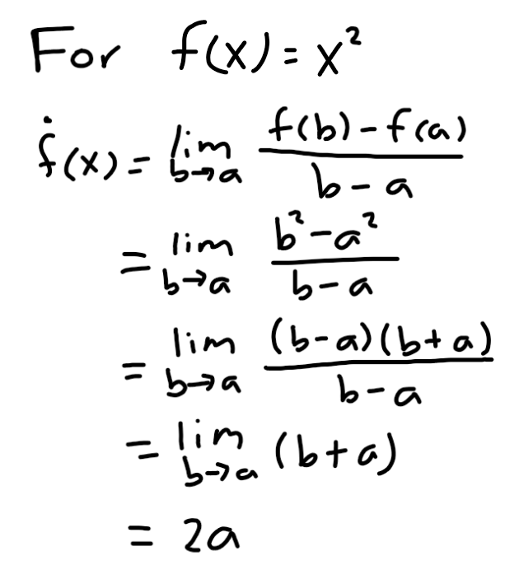
Power rule
What about for a polynomial?
We can do some manipulation of the derivative formula for a polynomial and find that, in general, the derivative of the function y = x^{n} is dy/dx = nx^{n-1} where n is a non-zero integer.

Slide 11
Coefficients of a polynomial
Notice that p(0) = c₀.
Let p’ = dp/dx. Then, p’(x) = c₁ + 2c₂x + 3c₃x² . . ., so p’(0) = c₁.
We can continue taking derivatives to get p’’ = dp’/dx = 2c₂ + 6c₃x + . . . and p’’’ = dp’’/dx = 3c₃.
Thus, p’’(0) = 2c₂ and p’’’(0) = 6c₃ = (3!)c₃.
Let us define p^{(a)} to be the “a”th derivative of the polynomial p(x). In other words, the result when we take the derivative of p(x) “a” times.
Then p^{(a)}(0) represents the value of the function p^{(a)}(x) at x = 0.
In general to find c_{a}, where a is an integer between 0 and n inclusive, we can use the equation c_{a} = p^{(a)}(0)/(a!).

Slide 12
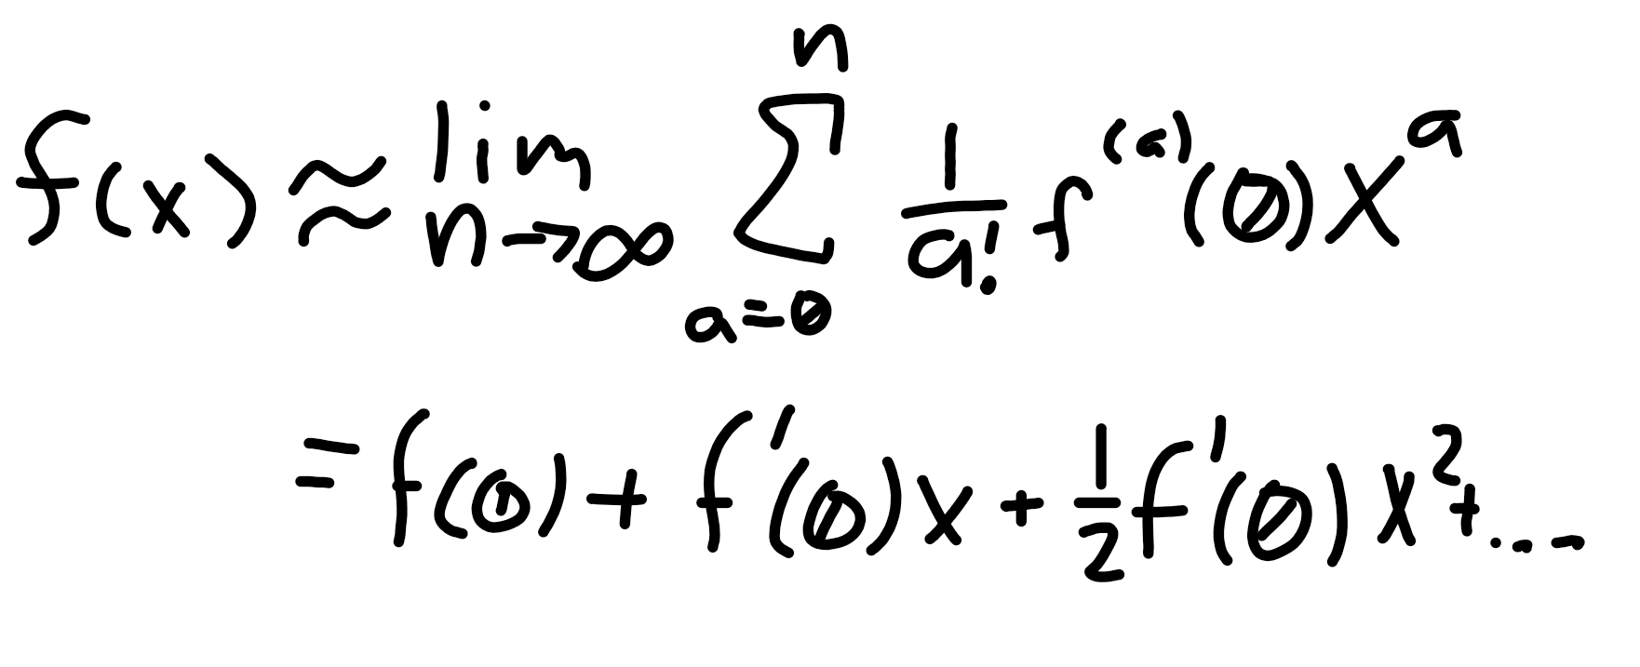
Taylor approximation (at x = 0)
Let us try to approximate a function f(x) as a polynomial p(x). Thus, we treat f as a polynomial.
The polynomial is formed from many “monomial” terms c_{a}xª.
We know c_{a} = f^{(a)}(0)/(a!), so c_{a}xª = [f^{(a)}(0)/(a!)]xª.
We can write out each and every term to get f(x) ≈ f(0) + f’(0)x + [1/2]f’’(0)x² + [1/(3!)]f’’’(0)x³ . . . with more terms.
This is called the Taylor expansion of f(x) at the value x = 0, also known as the Maclaurin series of a function.

